Slide 1
Sreeram Jayaram
MS Business Analytics
University of Texas at Dallas

Slide 2
Problem 1

Slide 3
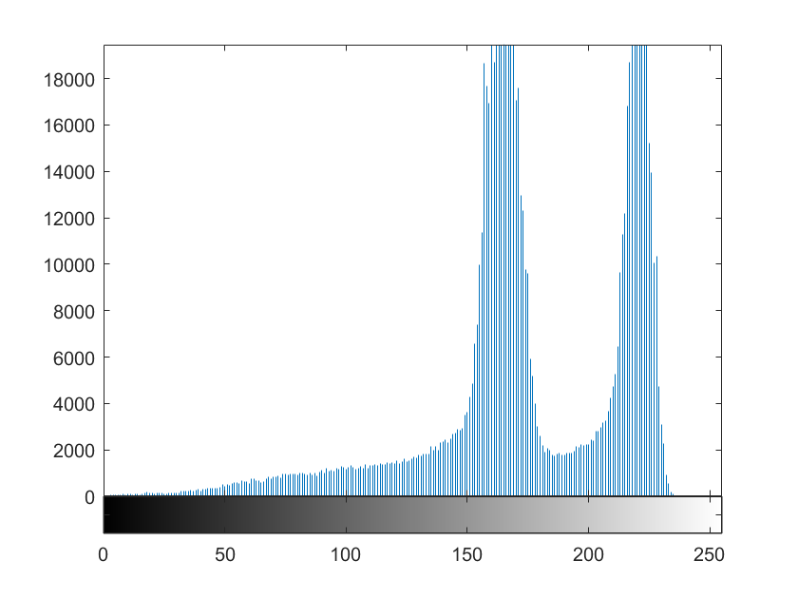
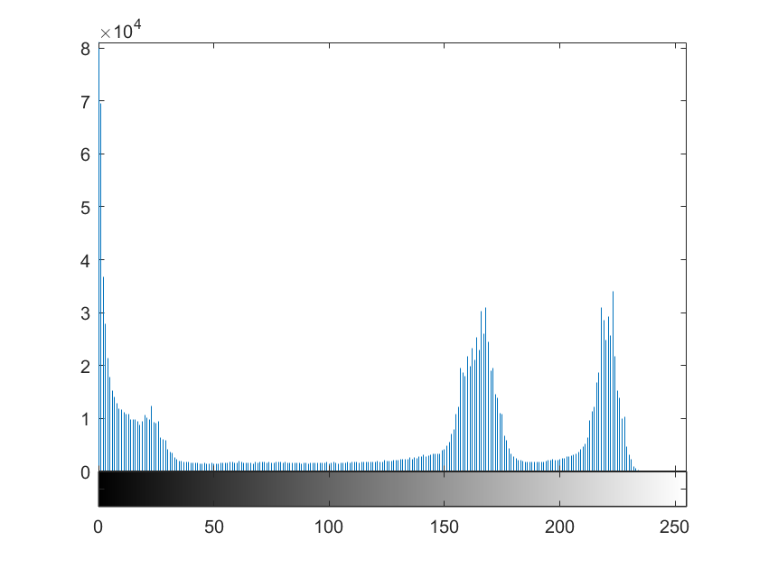

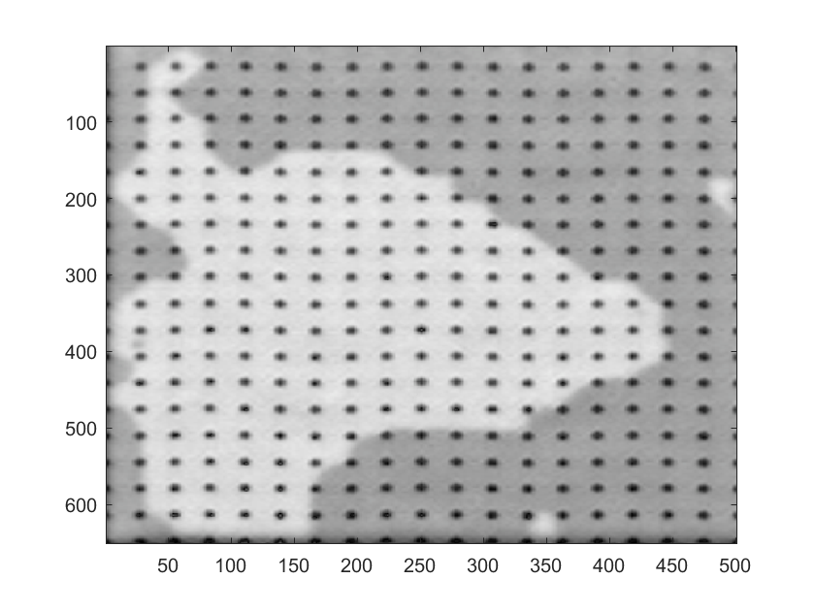
MatLab for image processing
Left Main Image shows the intensity of given
Right Image shows the intensity of finding the area

Slide 4


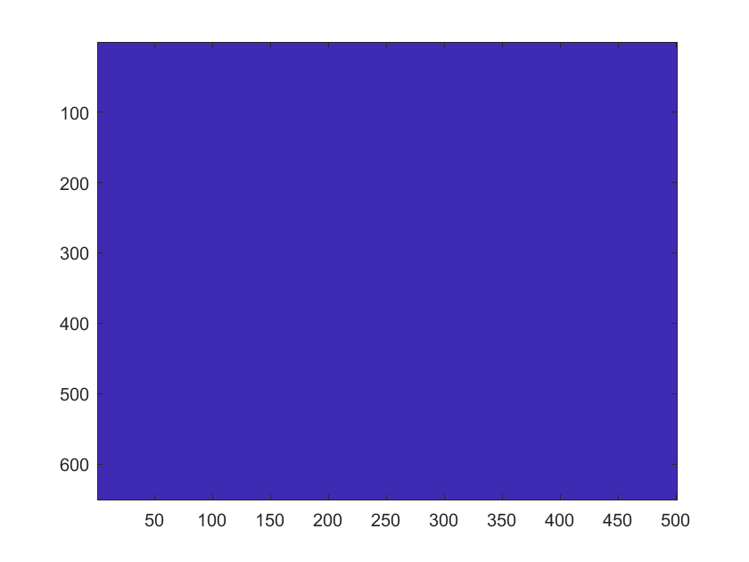
Problem 1
Extracted the area of the portion which need to be calculate its intensity is above .8
Filled the spaces in the image
To Calculate the total of the image.

Slide 5
Result
Total
Total Area Highlighted in Red = 133942
Total
Total Area Highlighted in Blue = 326151
Portion
Portion of it is 0.4291

Slide 6
Problem 2

Slide 7
Dependencies & Assumption
Separate the given text file and converted it as Excel file.
1
The unique nodes are extracted using R
2
Assumed the all the nodes are used for prediction.
3
Consider [NodeId: 9918] is not present in left column but it is presented in right column. Since it is Swing node pulled the friends list of this node from 1st column.
4
Assuming if a swing node has a friends list who is a also a swing node excluding those node from the decision.
5

Slide 8
Approach
Counted the X candidate supporters from the nodes which ends with 0,1,2,3
Counted the Y candidate supporters from the nodes which ends with 4,5,6,7
Separated the Swing nodes which ends with 8,9.
Infile
If node end
Count of X
Swing Node
Count of Y

Slide 9
Thought Process
Swing Nodes friends list
Swing Node determination if their friends list supporter count are different
If 0,1,2,3 or 4,5,6,7
Count Particular Swing Node friends X supporter
Count Particular Swing Node friends Y supporter
If X > Y
Swing Node will become X or Y Supporter

Slide 10
Node has equal supporter for both candidate
If a swing node has friends with equal supporter.
Assigning their vote in alternative manner.
In between if there is any swing node is updated then the value of globalvariable will be allocated with alternative value.

Slide 11
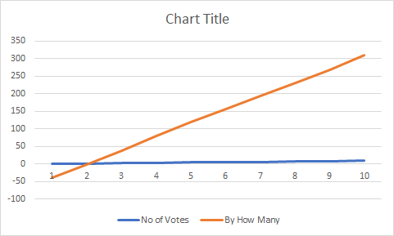
Influential Node
Determining the Influential node by calculating the highest degree for a particular node.
Determined 9 Influential node and again it will go into thought process.
Finally plotted the graph if 9000$ is spend for influential node how much difference the Y candidate will won.

Slide 12
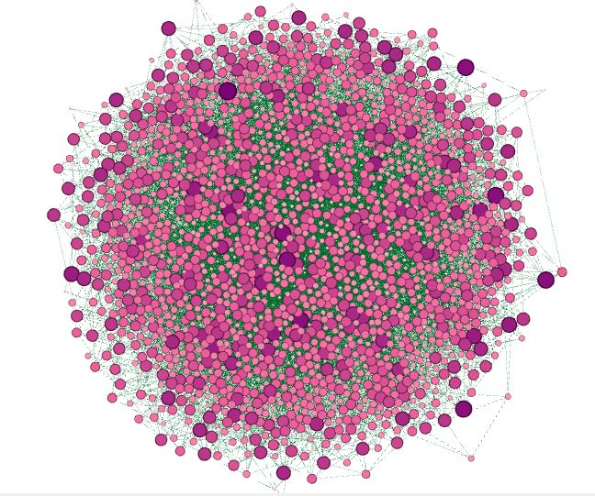
Plotted top 2000 Nodes sorted from High degree using Gephi

Slide 13


